Slide 1
SENIOR SHIELD
PROJECT FOCUS
✓
Scam awareness and digital safety
Pause. Verify. Stay Protected.
A mobile cybersecurity app to help older adults recognize scams, phishing messages, and fraudulent calls.
Designed with clarity, confidence, and safer decisions in mind.
PROJECT TEAM
Jana Sadek • Gena Sadek • Rokaya Mostafa • Adham Ahmed • Abdelrahman Waleed • Mohamed Ismail
PHASE 1 • CYBERSECURITY

Slide 2
The Problem & the Gap
PROBLEM
THE PROBLEM
THE GAP
Older adults may receive fraudulent phone calls, text messages, or emails. It can be difficult to tell whether a message is genuine, which may lead someone to click a harmful link or trust a scam.
There is a need for a simple, accessible app that helps older adults recognize common warning signs and understand what steps to take to stay safer online.
Opportunity: make scam awareness easier to understand and act on.
SENIOR SHIELD | CYBERSECURITY PROJECT
02 / 10

Slide 3
Target Users & Our Solution
USERS AND SOLUTION
TARGET USERS
OUR IDEA
OUR SOLUTION
Older adults who use smartphones.
Potential users to consult: older relatives or community members.
A simple app that teaches older adults how to recognize scams and practise safer online habits.
Clear explanations, visual examples, and step-by-step guidance to support safer online decisions.
Design principle: keep the experience clear, reassuring, and easy to navigate.
SENIOR SHIELD | CYBERSECURITY PROJECT
04 / 10

Slide 4
Three Ideas — and Why Senior Shield
IDEA SELECTION
01 SENIOR SHIELD
02 SENIOR CARE
03 EASY TECH GUIDE
Problem: Older adults may not recognize online scams.
User: Older adults.
Value: Helps users make safer decisions online.
Problem: Older adults may forget daily tasks.
User: Older adults.
Value: Helps users remember important tasks.
Problem: Some people find smartphone settings difficult.
User: People who need smartphone help.
Value: Explains settings in simple steps.
OUR CHOICE
We chose Senior Shield because scams can cause financial loss and expose private information. Its planned features are realistic for our team to build.
SENIOR SHIELD | CYBERSECURITY PROJECT
03 / 10

Slide 5
Literature Search & Research Record
RESEARCH
WHERE WE SEARCHED
SEARCH TERMS & FILTERS
WHAT WE WILL RECORD
• Google Scholar
• PubMed
• Federal Trade Commission (FTC)
Search terms
• Online scams and older adults
• Phishing and older adults
• Online safety for seniors
• Easy-to-use security apps
Filters
• English-language sources
• Academic studies and trusted reports
• Focus on older adults and online safety
• Search dates
• Filters used
• Number of results
• Selected sources
Research plan
We plan to use 2–3 studies or reports, including at least one academic study, to better understand the problem and inform feature choices.
SENIOR SHIELD | CYBERSECURITY PROJECT
05 / 10

Slide 6
Weighted Decision Matrix
DECISION-MAKING
Criteria | Weight | SeniorShield | SeniorCare | EasyTech Guide
User need | 30% | 5 | 3 | 4
Feasibility | 25% | 4 | 5 | 5
Gap left | 20% | 4 | 3 | 3
Mobile fit | 15% | 5 | 5 | 4
Risk | 10% | 4 | 4 | 4
Total | 100% | 89 | 78 | 81
SENIOR SHIELD | CYBERSECURITY PROJECT
06 / 10

Slide 7
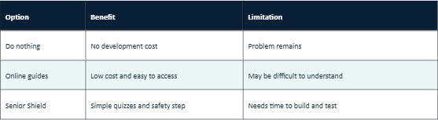
Comparing solutions, SWOT Analysis ,cost and benefits
PROJECT EVALUATION
Cost and benefits
Cost : development time, testing, tools needed
Benefits: online safety awareness, simple learning, helps for the community.
STRENGTHS
weakness
Simple and easy to use
Cannot detect every scam automatically
OPPORTUNITIES
RISKS / THREATS
Scam changes over time
add Arabic and use customer feedback.
SENIOR SHIELD | CYBERSECURITY PROJECT
07 / 10

Slide 8
App Features & Project Brief
SCOPE
PROJECT OBJECTIVE
Build a simple mobile app that helps older adults recognize scams and learn basic online safety.
MUST-HAVE FEATURES (MVP)
NICE-TO-HAVE FEATURES
1. Scam Spotter Quiz — choose whether a sample message is safe or suspicious.
2. Emergency Scam Helper — guidance after clicking a suspicious link or sharing private information.
3. Device Security Checklist — passcodes, screen locks, and privacy settings.
4. Simple Security Score — track completed basic security steps.
• Arabic language option
• Additional quiz questions
• Save favourite safety tips
PROJECT SCOPE
Design at least four screens, build the main features, and test the app with older users.
SENIOR SHIELD | CYBERSECURITY PROJECT
08 / 10

Slide 9
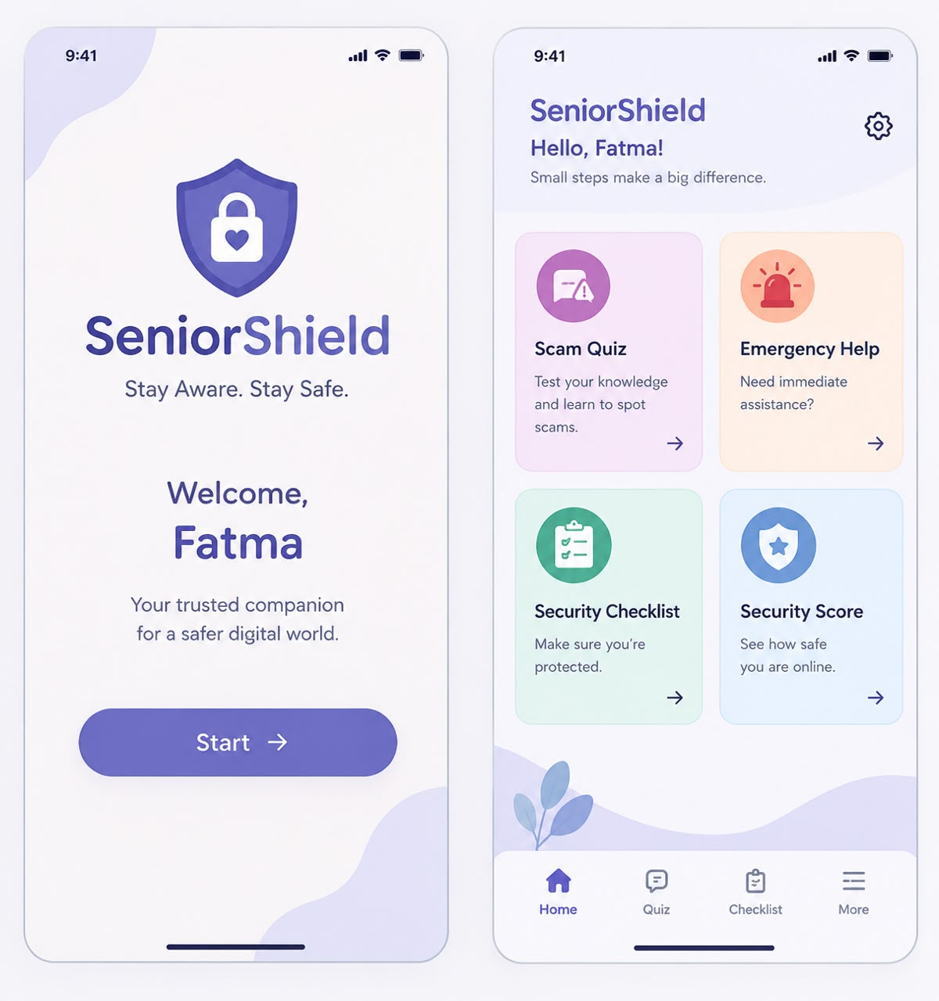
Screen Designs & User Journey
USER EXPERIENCE
01 WELCOME
App name, welcome message, and a clear Start button.
02 HOME
Quick access to Scam Quiz, Emergency Help, Security Checklist, and Security Score.
03 SCAM QUIZ
A sample text message with “Safe” and “Suspicious” choices.
04 RESULTS & ADVICE
Correct answer, warning signs, and the next safe step.
Users can return to Home to access the other features.
SENIOR SHIELD | CYBERSECURITY PROJECT
09 / 10

Slide 10
Customer Discovery, Stakeholders & Success Criteria
VALIDATION
CUSTOMER DISCOVERY
STAKEHOLDERS
SUCCESS CRITERIA
Planned approach: speak with older relatives or community members to understand their online-safety needs.
Questions to ask
1. Have you received a suspicious call or message?
2. How do you tell whether a message is fake?
3. What would make this app easy to use?
Customer feedback: add real answers after the interviews.
• Older adults: use and test the app.
• Family or community members: help identify user needs.
• Project team: plans and builds the app.
• Lecturer: reviews the project.
1. At least 4 out of 5 users complete the main quiz without help.
2. At least 80% identify scam examples after using the app.
3. All four main features work correctly during testing.
SENIOR SHIELD | CYBERSECURITY PROJECT
10 / 10

